Slide 1
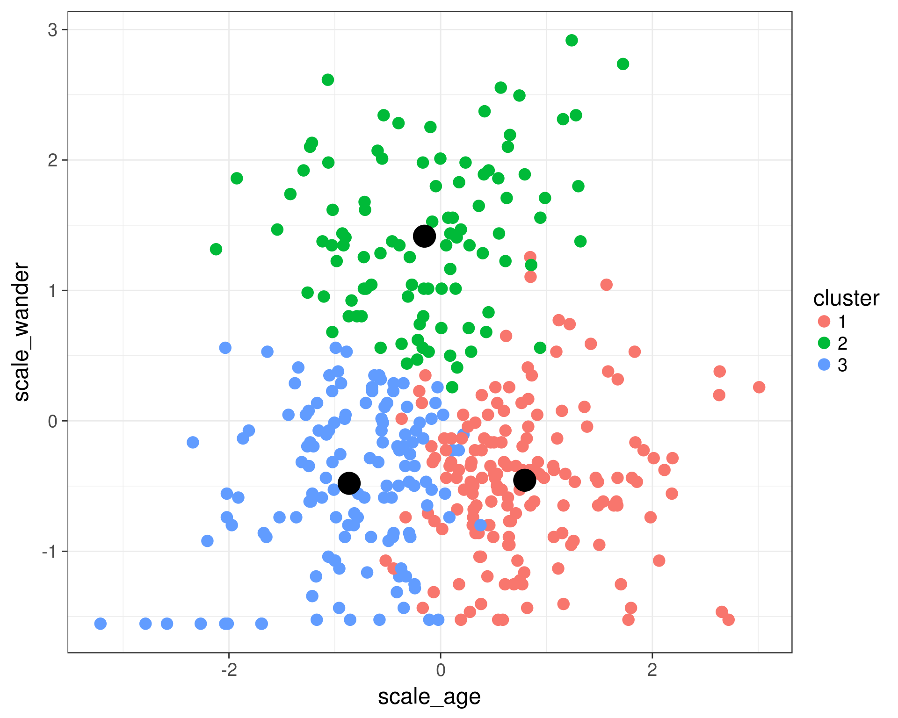
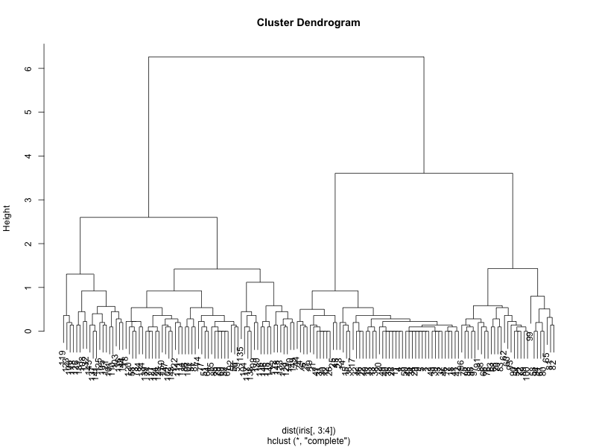
Week 11:Clustering
Geog4300: Shannon

Slide 2
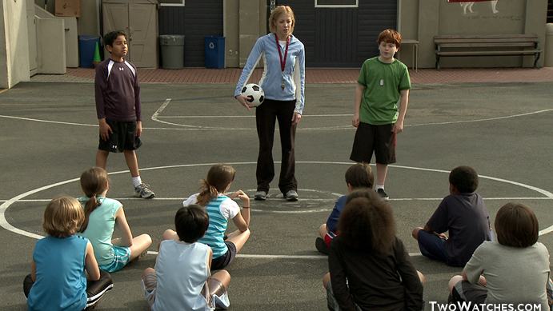
K-means
Picks a set number of “seeds” and then groups based on similarity.
Notes:
Alternative hypothesis is usually what you’re trying to prove.

Slide 3
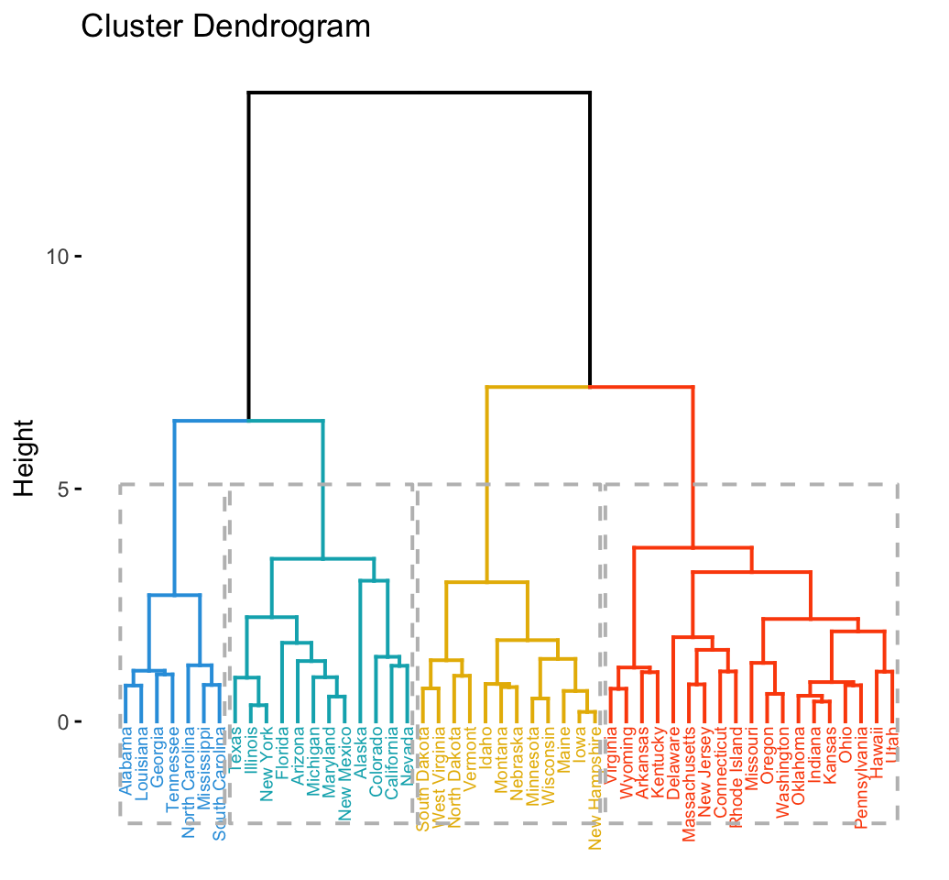
Hierarchical clustering (HCA)
Notes:
Alternative hypothesis is usually what you’re trying to prove.

Slide 4
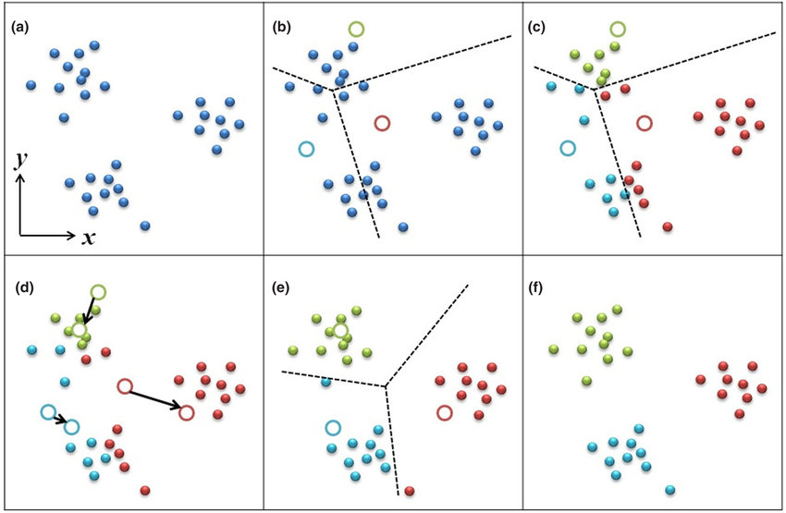
K-means
Highly dependent on the initial “seeds”
Notes:
Alternative hypothesis is usually what you’re trying to prove.

Slide 5
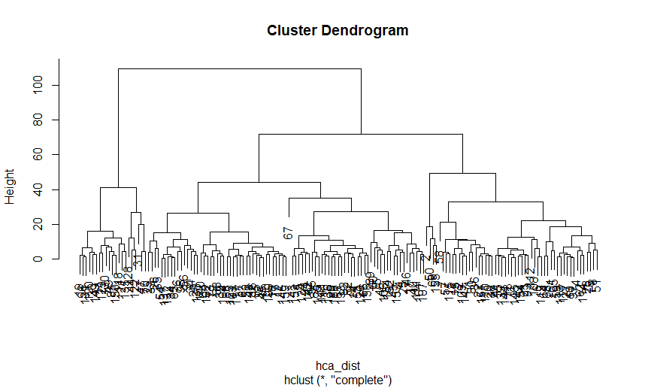
Racial clusters in Georgia
Using HCA: How many clusters?
Notes:
Alternative hypothesis is usually what you’re trying to prove.

Slide 6
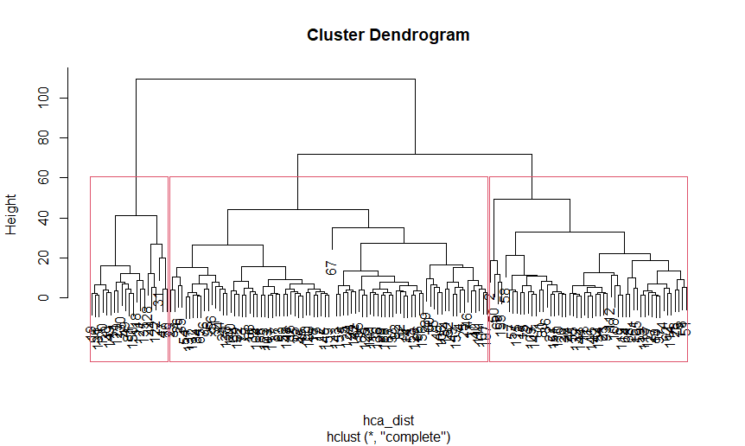
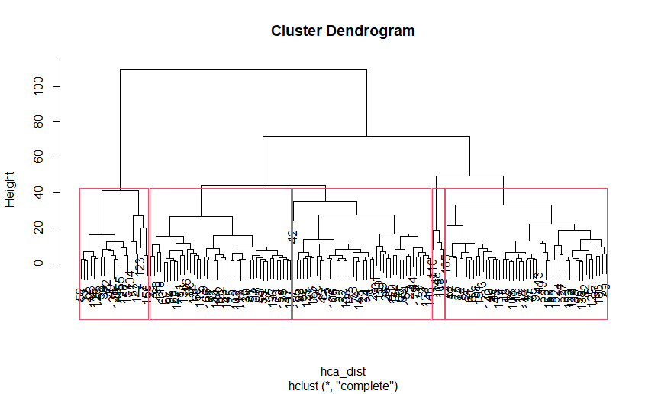
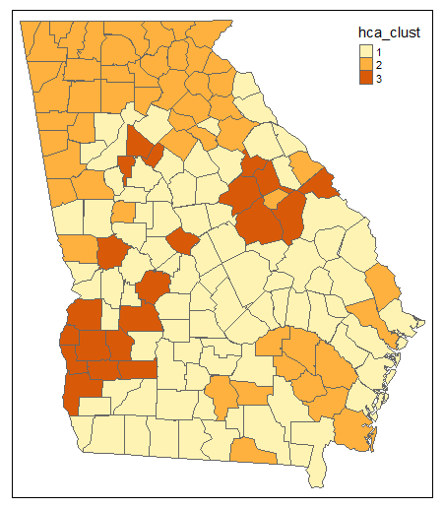
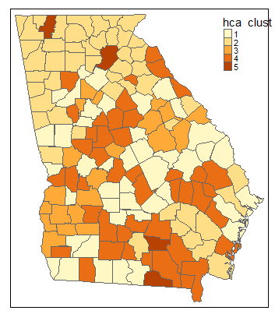
Racial clusters in Georgia
Three clusters
Five clusters
Notes:
Alternative hypothesis is usually what you’re trying to prove.

Slide 7
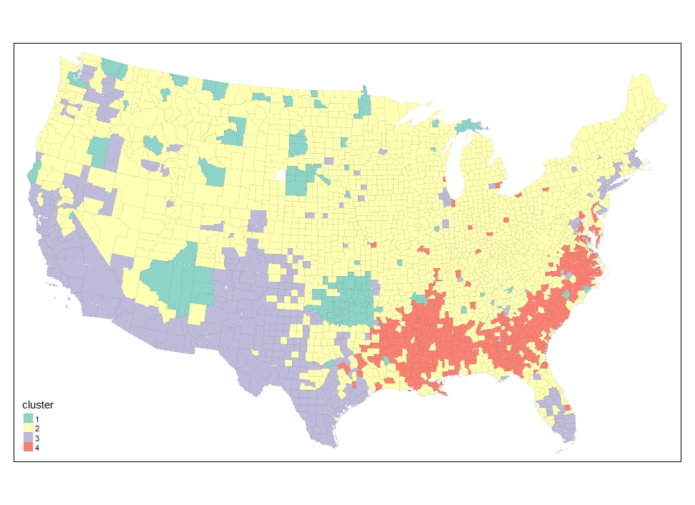
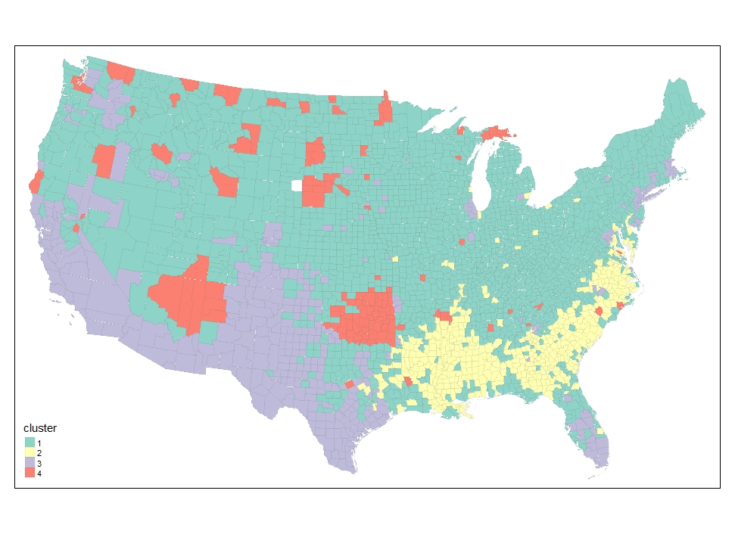
Let’s look at our county data!
Two cluster maps just based on the race/ethnicity variables using k-means
Notes:
Alternative hypothesis is usually what you’re trying to prove.

Slide 8
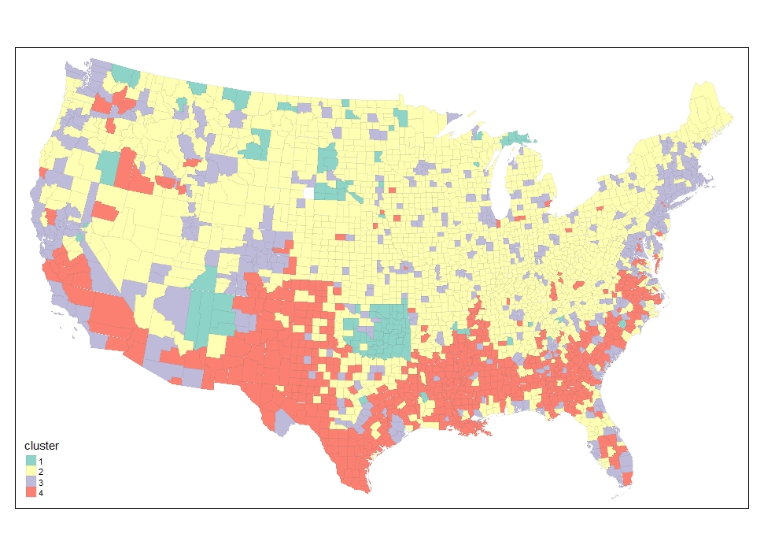
Let’s look at our county data!
Now let’s add in education variables
Race/ethnicity
Race/ethnicity + ed attainment
Notes:
Alternative hypothesis is usually what you’re trying to prove.

Slide 9
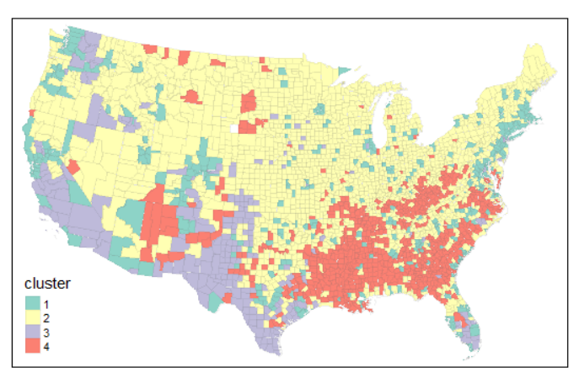
Let’s look at our county data!
Now let’s add in nativity variables
Race/ethnicity + ed attainment + nativity
Race/ethnicity
Race/ethnicity + ed attainment
Notes:
Alternative hypothesis is usually what you’re trying to prove.

Slide 10
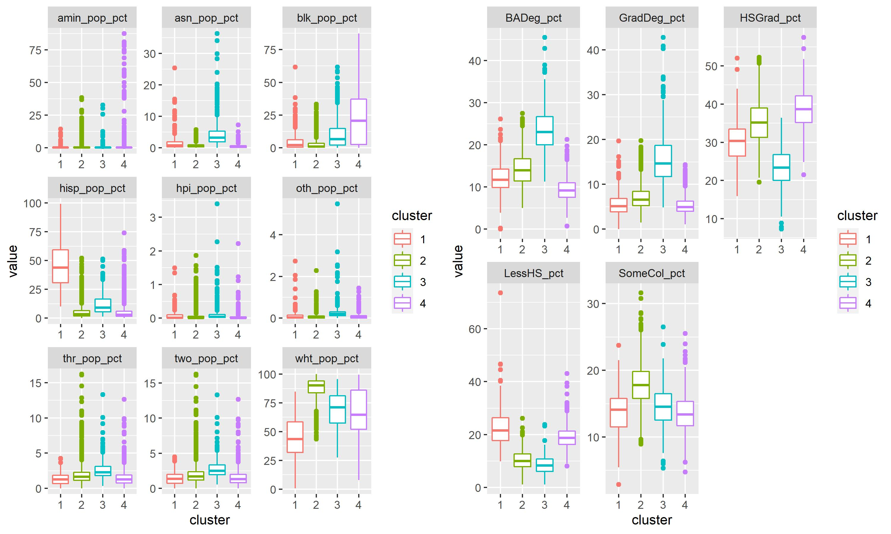
What do these clusters mean?
Ed + ethnicity
In groups:
Take one of these clusters and identify what makes it distinctive compared to the three others.
How would you title it?
Notes:
Alternative hypothesis is usually what you’re trying to prove.

Slide 11
Do these clusters make sense?
Race/ethnicity + ed attainment
Notes:
Alternative hypothesis is usually what you’re trying to prove.

Slide 12
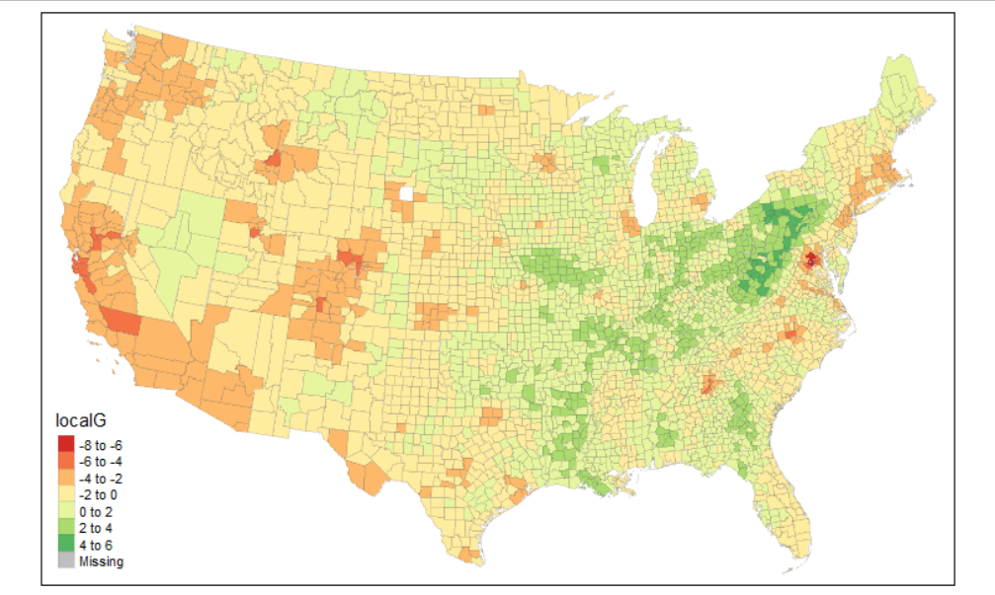
Clusters are different from spatial autocorrelation
Clusters:
Observations grouped by similarities across multiple variables
Spatial autocorrelation:
Neighboring areas with similar values for the same variable
HS Graduation is highest ed. attainment
Notes:
Alternative hypothesis is usually what you’re trying to prove.

Slide 13
Final project brainstorming
What’s the most interesting/important skills you’ve developed this semester?
What’s the most interesting data you’ve worked with?
How can you emphasize these in your final project?
Notes:
Alternative hypothesis is usually what you’re trying to prove.

Slide 14
Potential projects
Look at the data sources we’ve listed. What’s a question you could answer using one or more of them? How would it show off what you’ve learned?
Notes:
Alternative hypothesis is usually what you’re trying to prove.

